Slide 1
TaskBoard
1
DevOps Final Capstone Project — Session 21
A production-grade, full-stack SaaS project management application engineered from laptop to observable, multi-cloud Kubernetes.

Slide 2

📋 Agenda
M1
Application — Frontend, Backend & Database
Testing — Pytest Quality Gates
Docker — Containerization & Compose CI/CD — GitHub Actions Pipeline DevSecOps — Security Auditing & Trivy
M2
M3/M4
M5
M6
M7 | Terraform — AWS Infrastructure as Code
M8 | Kubernetes & Helm Orchestration
M9 | Observability — Prometheus & Grafana
M10 | Troubleshooting Lab
GitOps | Continuous Delivery — ArgoCD

Slide 3
🏗️ Architecture Overview
Git Commit
Developer pushes code to GitHub repository
▼
CI/CD Pipeline
Pytest • Vite Build • Docker Trivy Scan • GHCR Push
▼
Infrastructure
Terraform on AWS
VPC • Subnets • NAT • EKS
▼
Kubernetes
Helm Chart • Ingress
HPA • NetworkPolicies • PVC
▼
Observability
Prometheus Scraping Grafana Dashboards

Slide 4

🛠️ Technology Stack
Frontend
React 18, Vite, Vanilla CSS, Nginx 1.27 Alpine
CI/CD
GitHub Actions (Matrix, Trivy, GHCR)
Backend
Python 3.12, FastAPI, SQLAlchemy 2.0, Alembic, Uvicorn
Infrastructure
Terraform ≥ 1.5 — VPC, Subnets, IGW, NAT, IAM, EKS
Database
PostgreSQL 16 Alpine with PVC
Kubernetes
Helm v3, Deployments, Services, Ingress, HPA, NetworkPolicies
Testing
Pytest, Pytest-Asyncio, HTTPX, SQLite in-memory
Monitoring
Prometheus, Grafana, ServiceMonitor, PromQL
Containers
Docker multi-stage builds, non-root, Docker Compose
DevSecOps
Trivy, Bandit SAST, pip-audit SCA, Zero-Trust NetworkPolicy

Slide 5

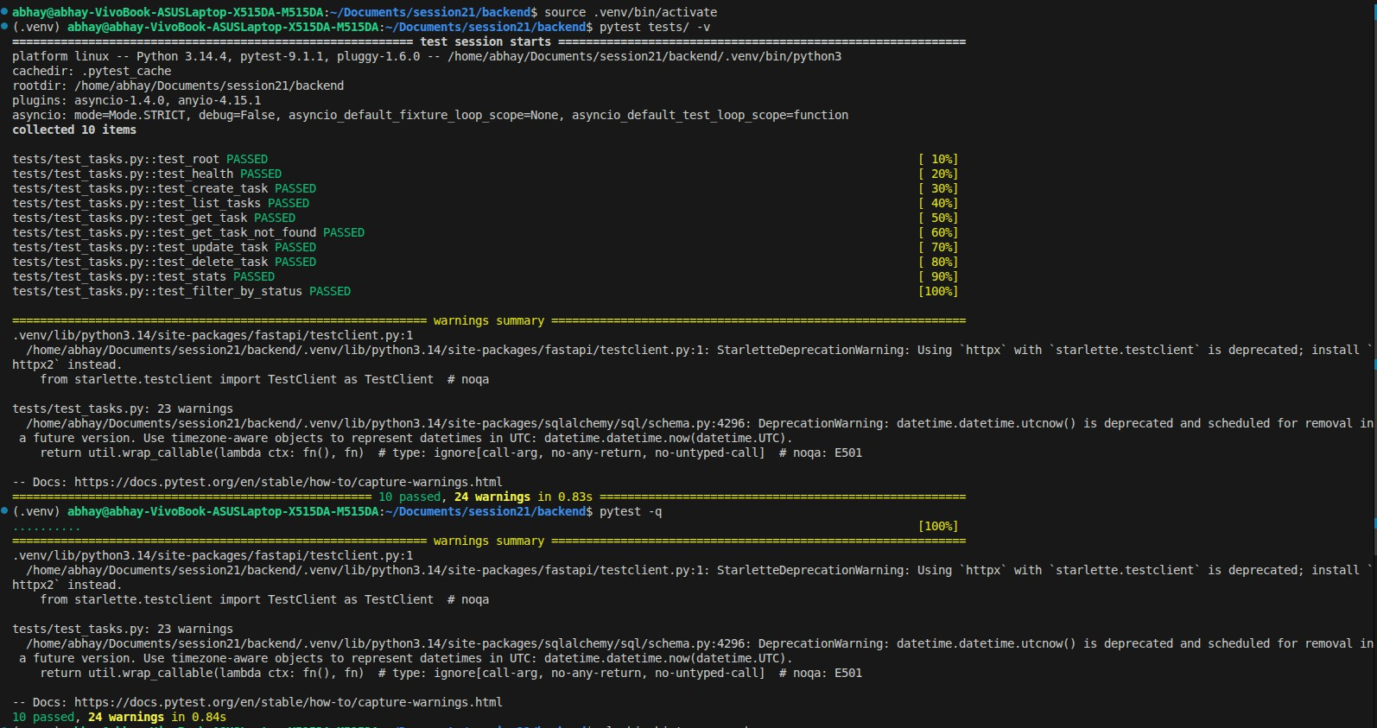
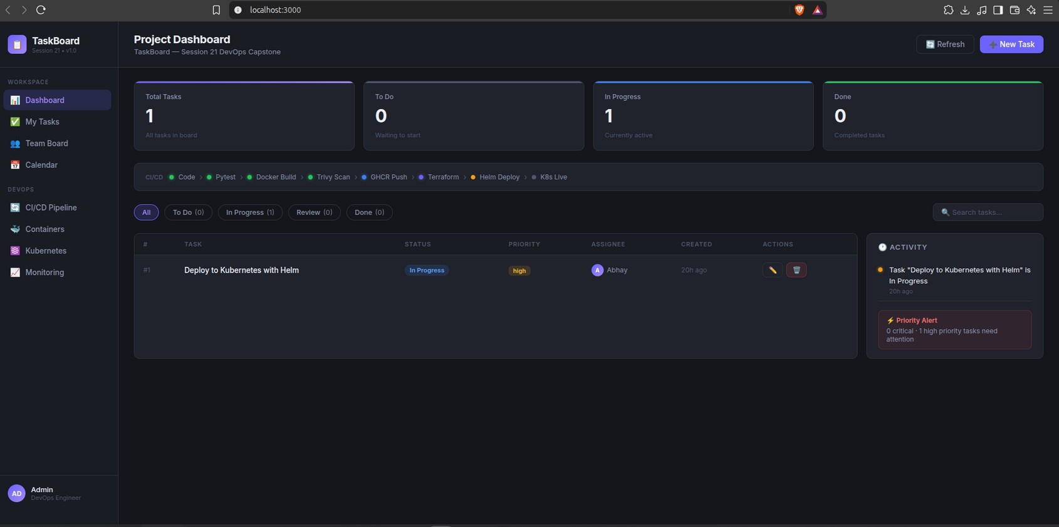
Application — Frontend, Backend & Database
M1
React 18 SaaS Kanban Board with real-time KPIs
Task creation modals, priority badges, status filters
FastAPI backend with SQLAlchemy ORM
PostgreSQL database with Alembic migrations
Schema tracked via 0001_create_tasks_table.py

Slide 6
Testing — Pytest Quality Gates
M2
10/10 integration tests pass before any build
Pytest + Pytest-Asyncio for async endpoint testing
HTTPX TestClient for real HTTP-layer assertions
SQLite in-memory fixtures for isolated DB testing
Tests validate every API endpoint and health probes
Zero failures required to proceed in CI pipeline

Slide 7
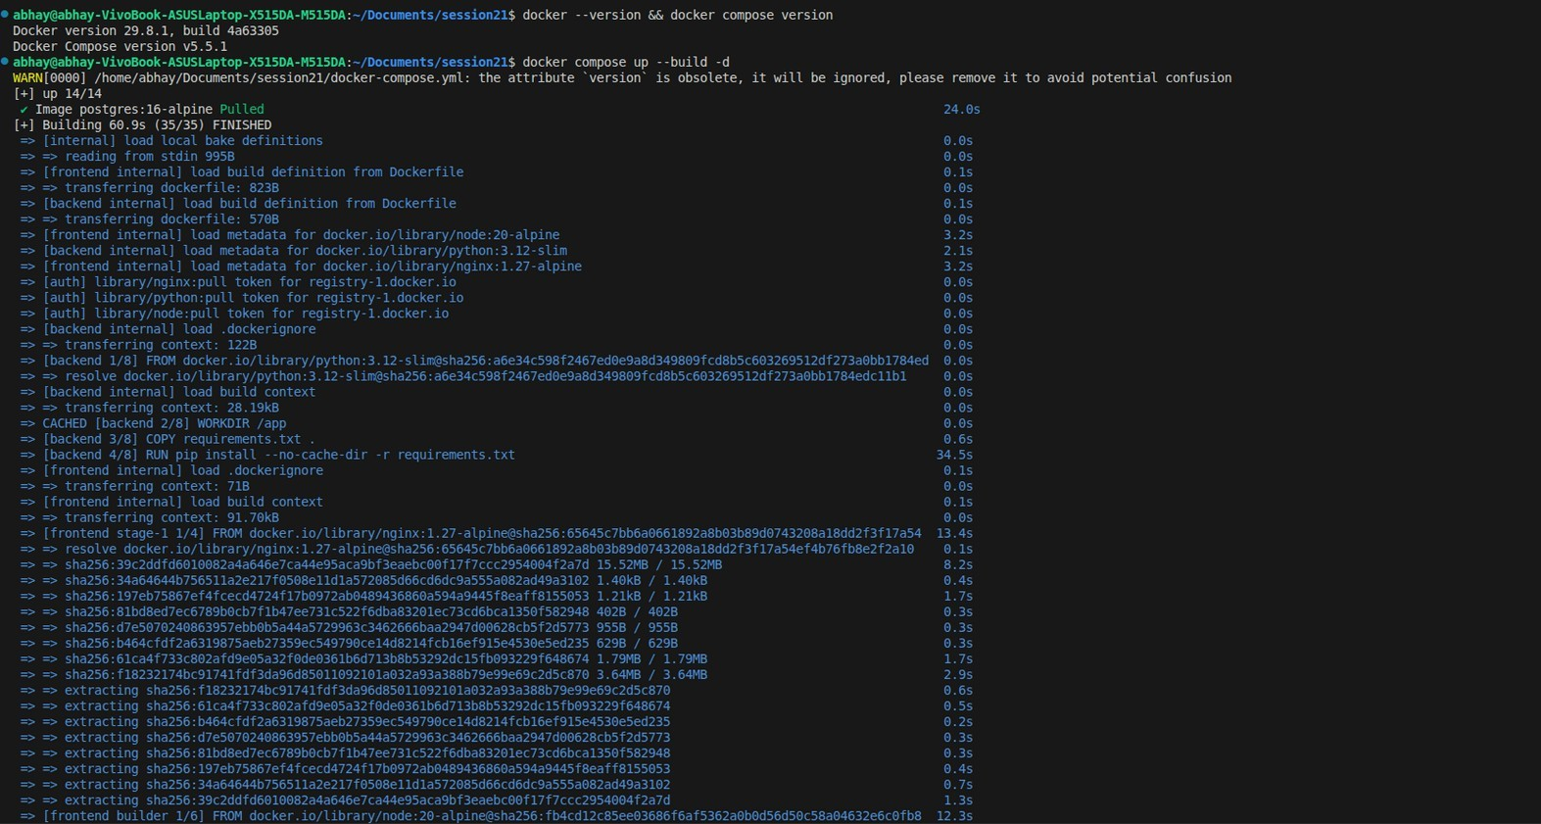
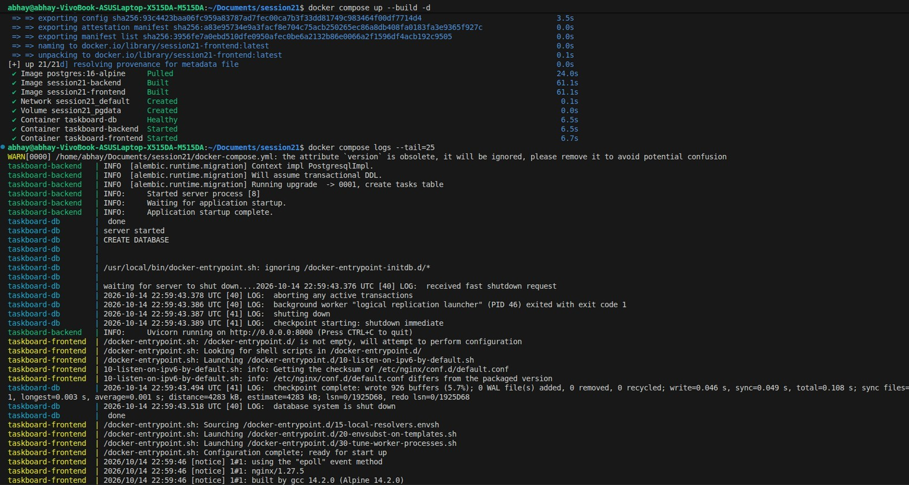
Docker — Containerization & Compose
M3 / M4
Multi-stage Dockerfiles for minimal image size
Backend: Slim Python 3.12, non-root appuser
Frontend: Node 20 build → Nginx Alpine runtime
Docker Compose orchestrates full local stack
Health checks on all containers
3 containers: taskboard-db, backend, frontend

Slide 8

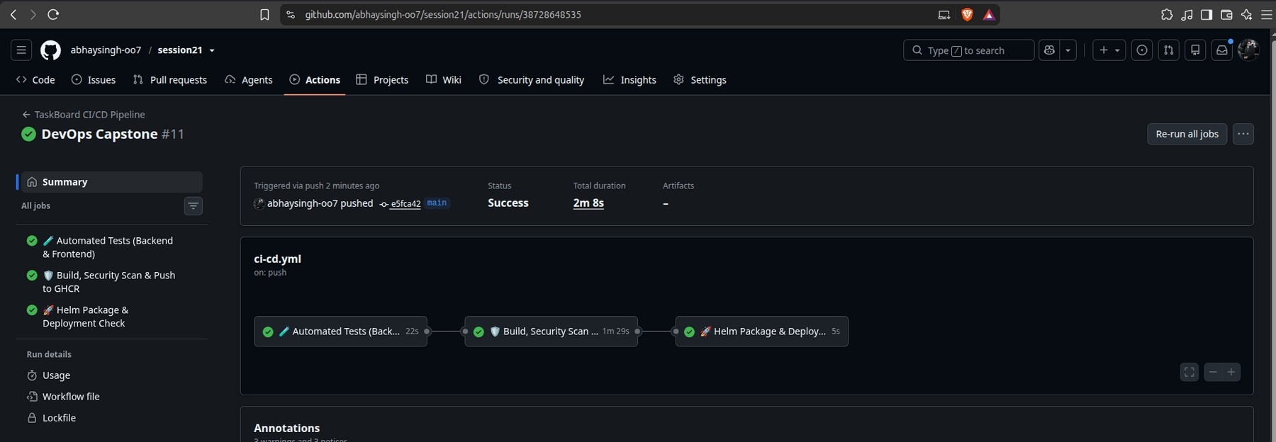
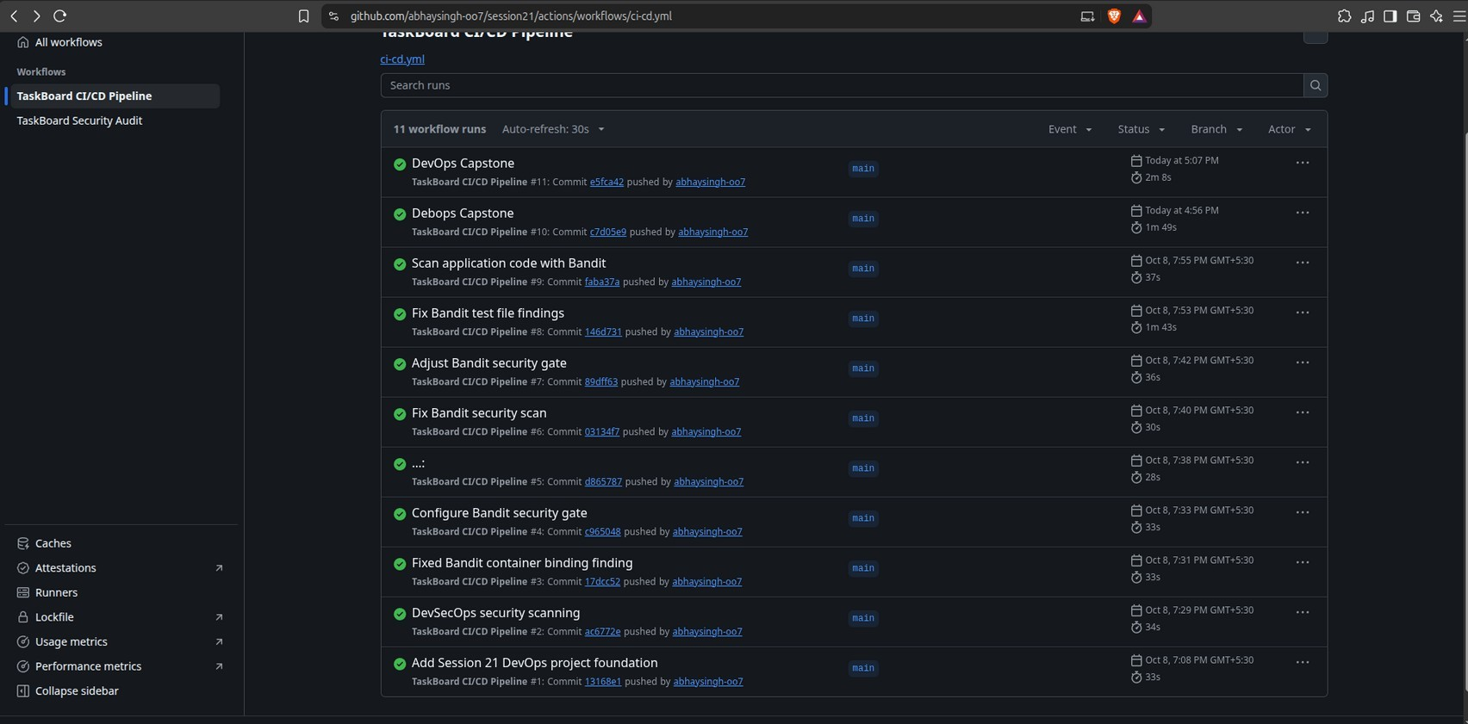
CI/CD — GitHub Actions Pipeline
M5
Stage 1: Test
Python 3.12 + Node 20 → Pytest + Vite Build
Stage 2: Scan & Build
Docker multi-stage build → Trivy Scan → GHCR Push
Stage 3: Deploy
Helm lint & dry-run template validation

Slide 9

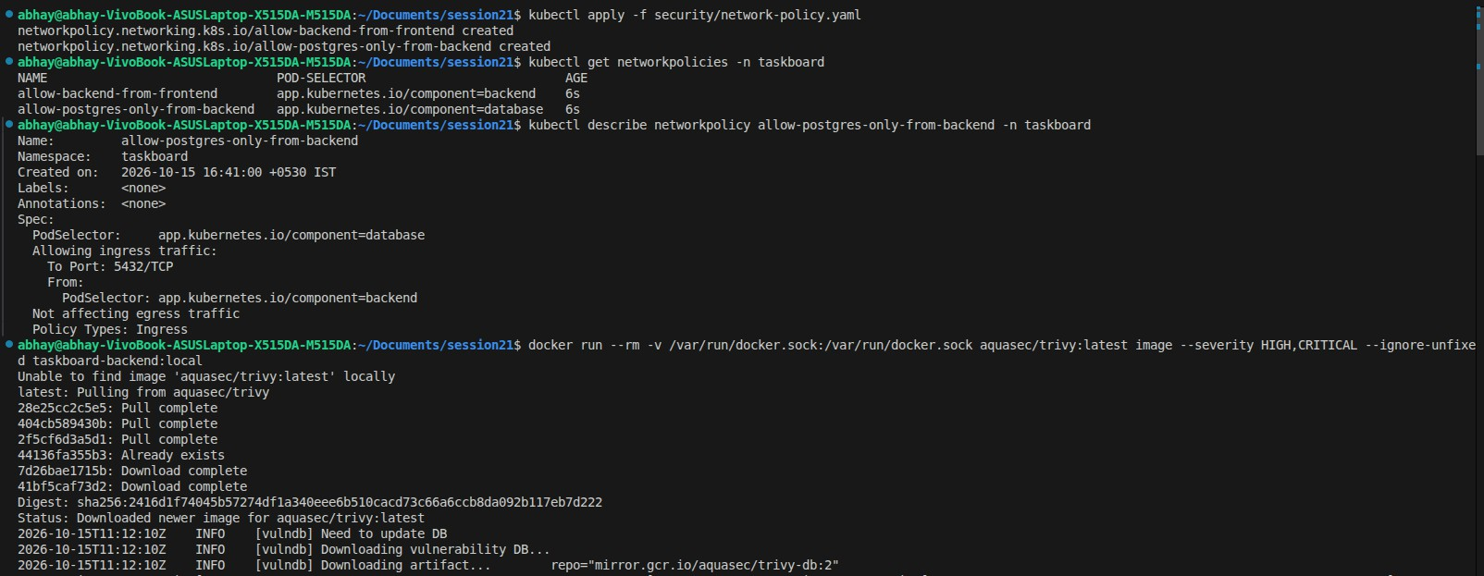
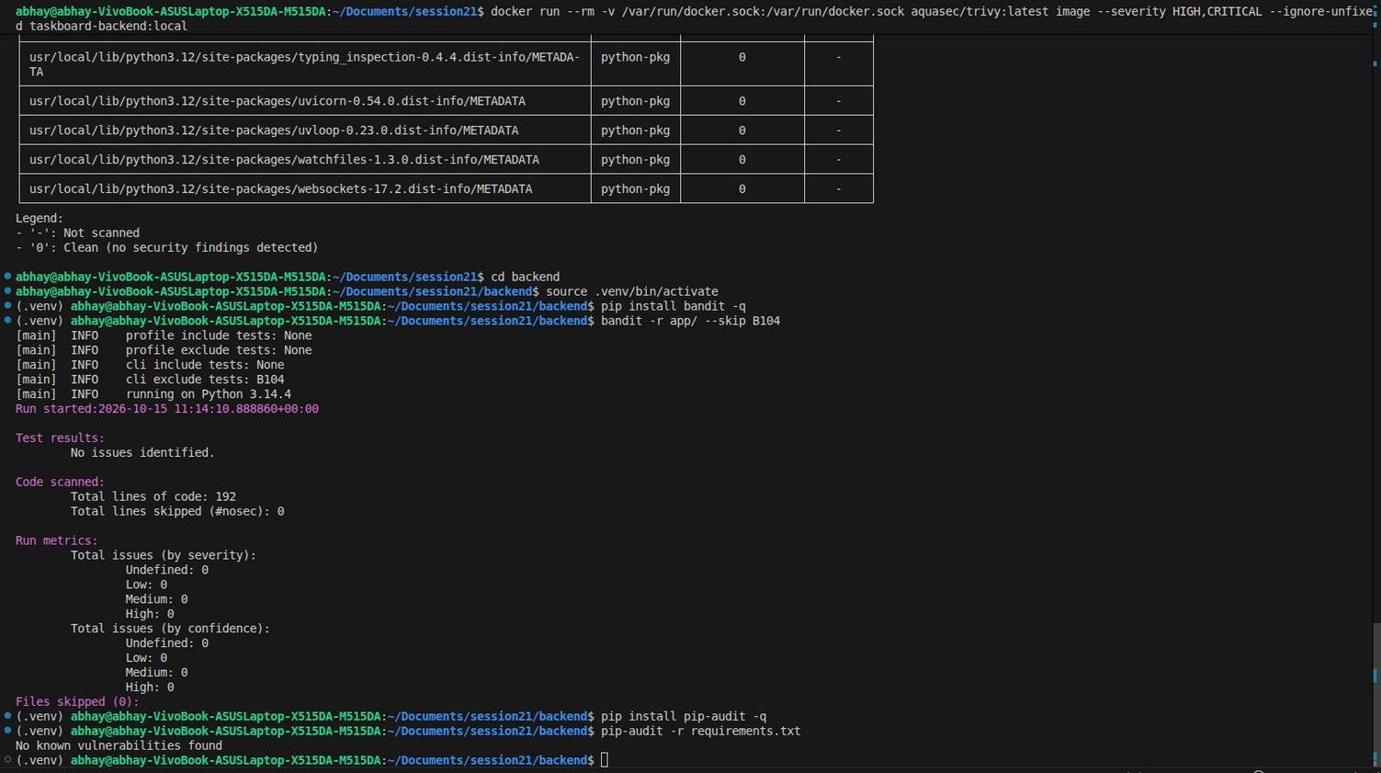
DevSecOps — Security Auditing
M6
🔍 Bandit SAST
Static analysis of Python code — 0 issues found
📦 pip-audit SCA
Dependency CVE scanning — 0 vulnerabilities
🐳 Trivy Scanner
Container image vulnerability scanning in CI
🔒 Network Policies
Zero-trust pod-to-pod traffic restrictions
👤 Non-root Containers
All containers run as unprivileged users

Slide 10
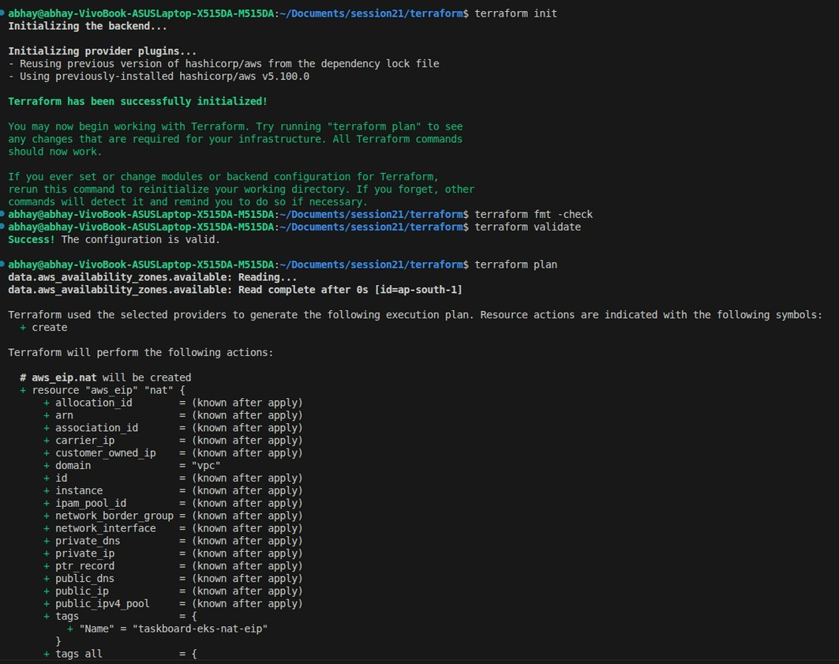
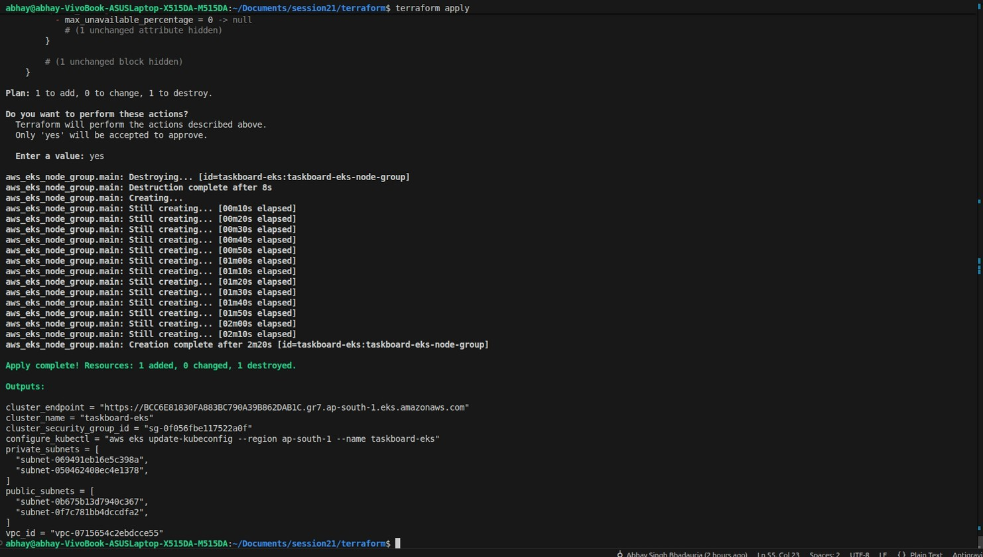

Terraform — AWS Infrastructure as Code
M7
VPC
10.0.0.0/16 — 2 Public + 2 Private Subnets
Networking
Internet GW + NAT GW with Elastic IP
EKS Cluster
v1.30 Managed control plane + IAM roles
Node Group
Amazon Linux 2023 EC2 in private subnets
📦 23 Resources Planned & Applied

Slide 11
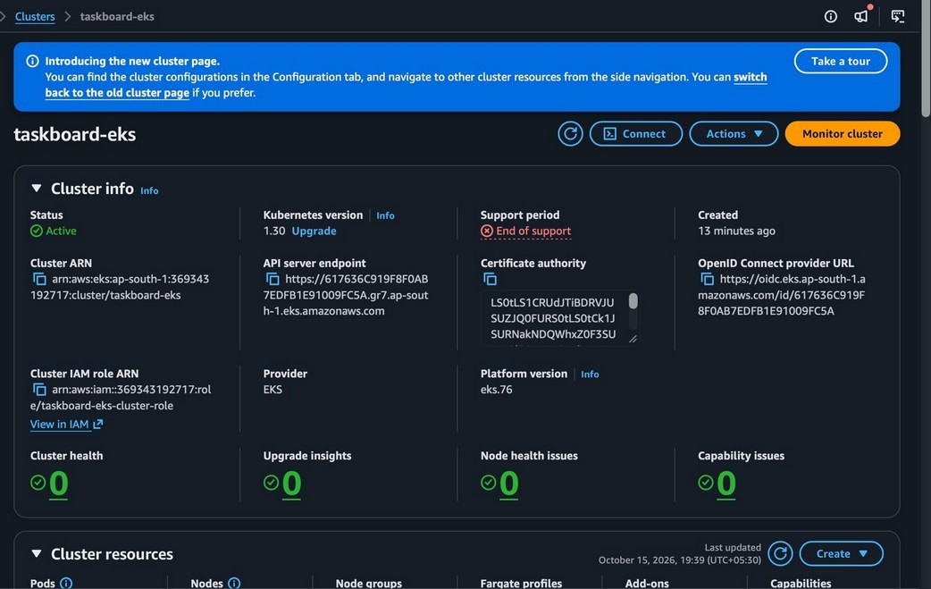
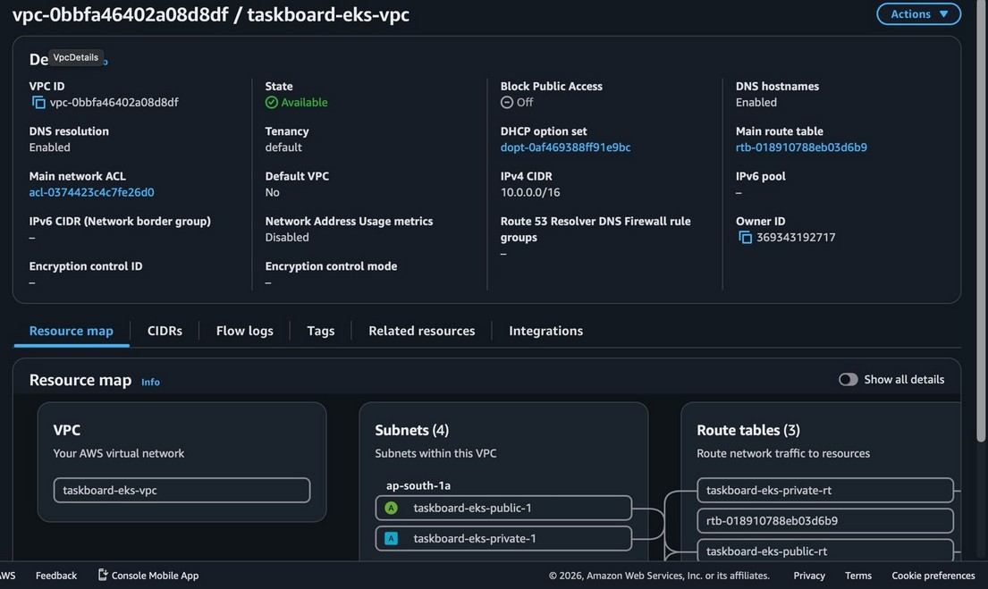
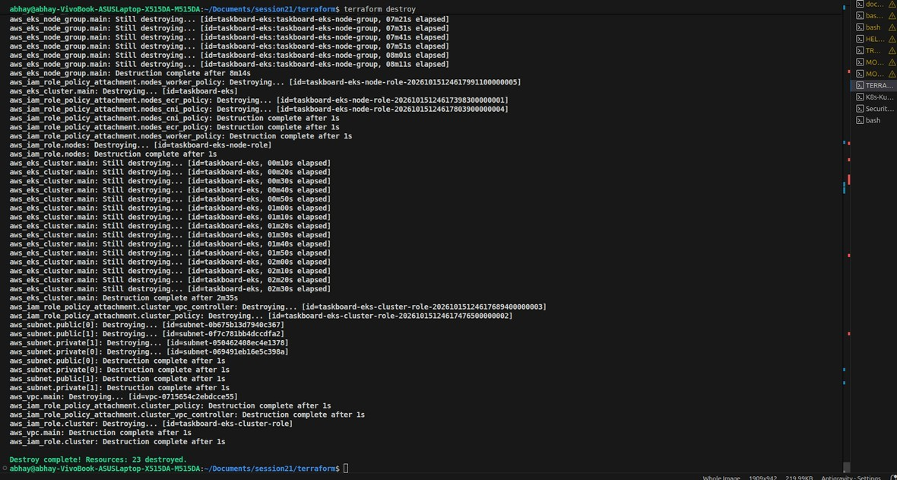
AWS Console Verification & Teardown
M7
EKS Cluster — Active on AWS Console
VPC & Subnets — Active on AWS Console
Clean Teardown — terraform destroy

Slide 12
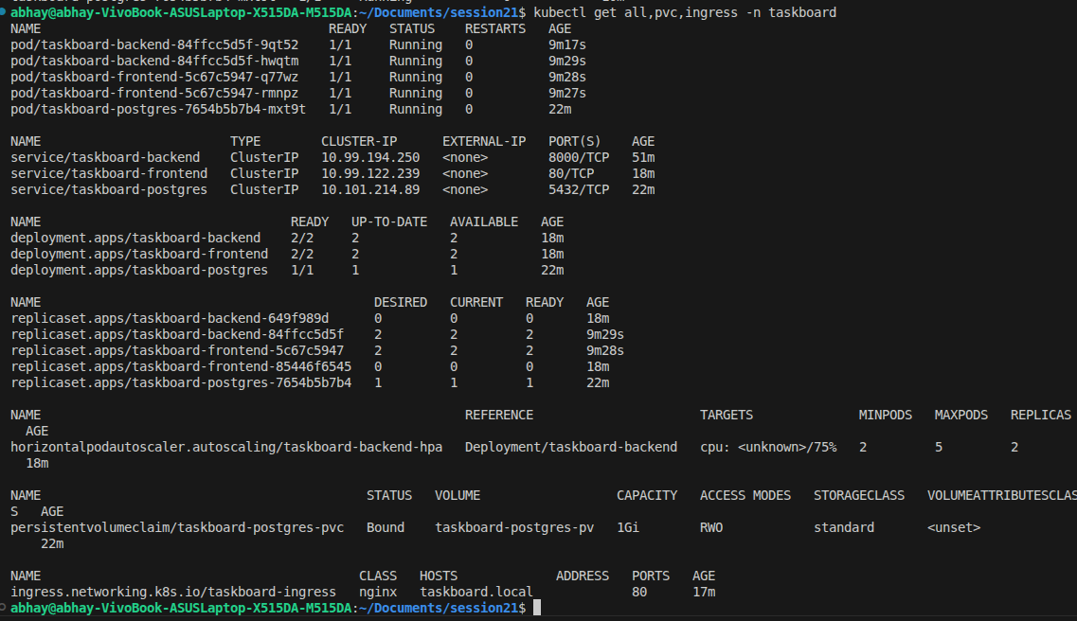
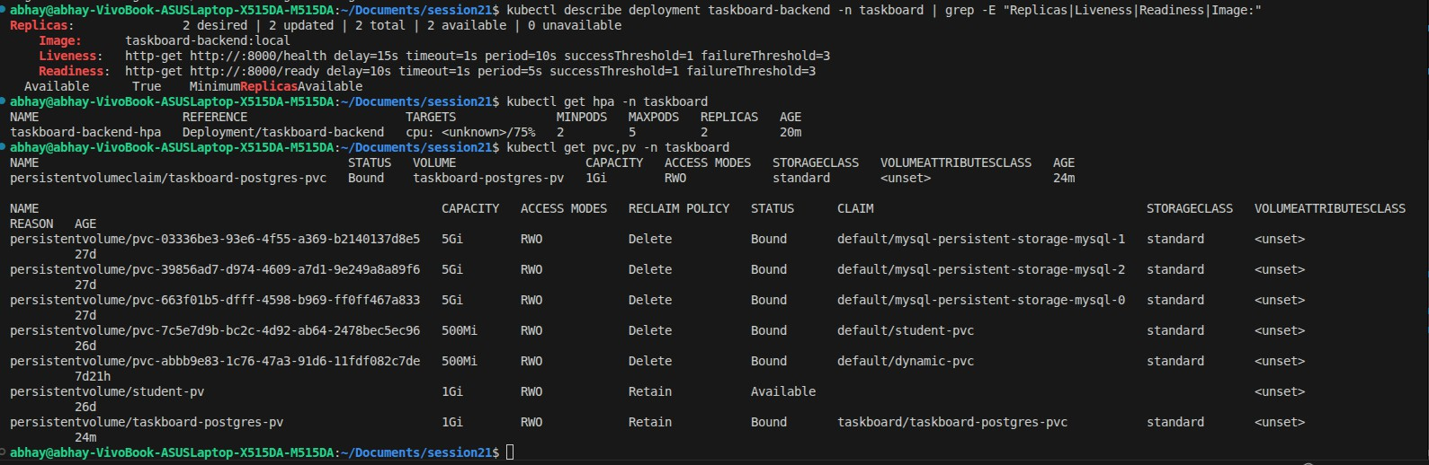
Kubernetes & Helm Orchestration
M8
Helm v3 chart in helm/taskboard — lint & template validated
Namespace isolation (taskboard namespace)
Ingress routing: / → Frontend, /api → Backend
Horizontal Pod Autoscaler (CPU > 75% threshold)
PostgreSQL 16 with PersistentVolumeClaim (Bound)
/health liveness & /ready readiness probes
Zero-Trust Network Policies enforced

Slide 13
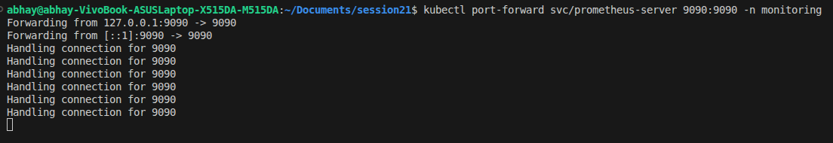
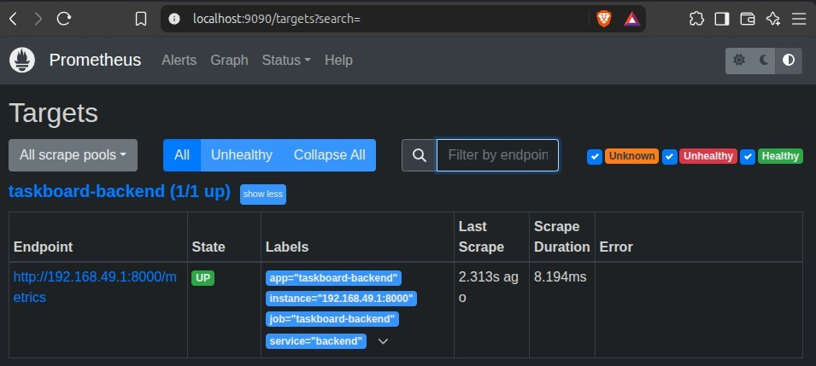
Observability — Prometheus Metrics
M9
FastAPI exposes /metrics endpoint (Prometheus format)
HTTP request counts, response latency histograms
System memory & CPU metrics exported
Prometheus scrapes targets every 5 seconds
All scrape targets show UP (1/1) status
Real-time PromQL queries for live monitoring

Slide 14
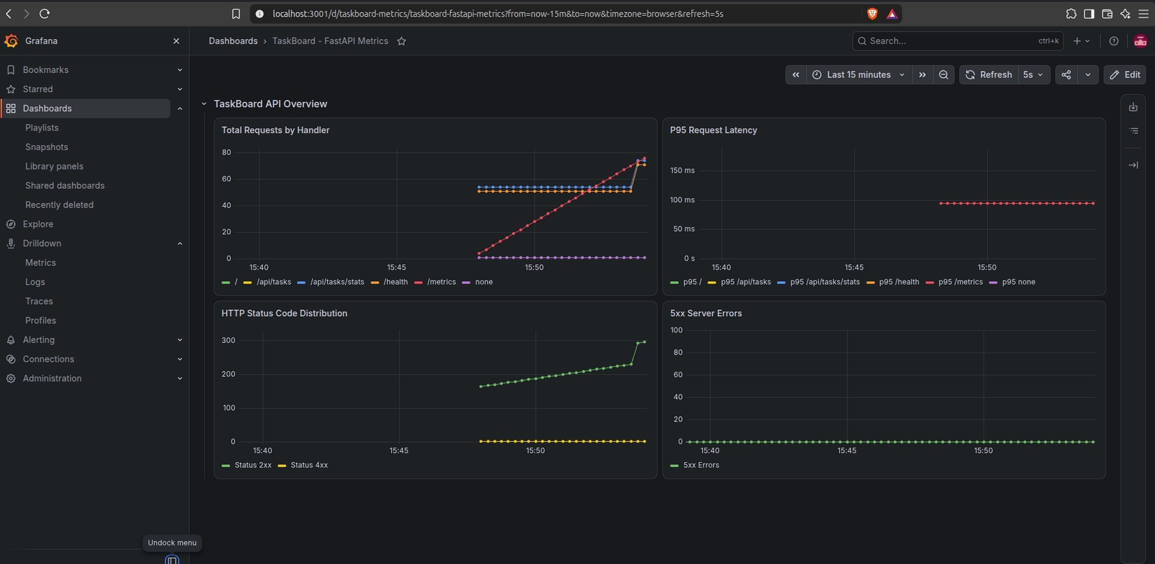
Grafana Production Dashboard
M9
📊 Total Requests by Handler
Live req/s rate visualization
⏱️ P95 Request Latency
95th percentile response time tracking
🚨 5xx Server Errors
Zero errors — clean production
📈 HTTP Status Breakdown
2xx / 4xx / 5xx code distribution

Slide 15
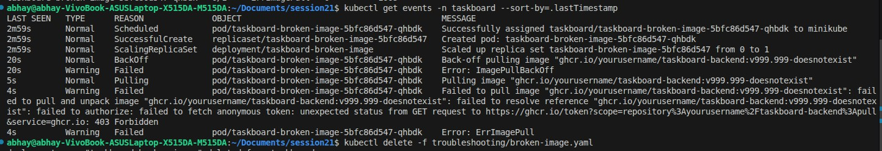
Troubleshooting Lab
M10
Exercise 1: Broken Image (ImagePullBackOff)
Diagnosing non-existent image tags
Using kubectl describe pod + cluster events
Exercise 2: Broken Service (Zero Endpoints)
Diagnosing mismatched label selectors
Identifying ENDPOINTS: <none> issues

Slide 16

GitOps Continuous Delivery — ArgoCD
GitOps
ArgoCD Application manifest in gitops/application.yaml
Continuously syncs helm/taskboard chart to Kubernetes
Automated sync with pruning & self-healing enabled
Source: github.com/abhaysingh-oo7/session21.git
Destination: kubernetes.default.svc → taskboard namespace
Declarative, Git-driven deployment model
Git Push
*
ArgoCD Detects
*
Helm Render
*
K8s Apply
*
Self-Heal

Slide 17
Thank You!
TaskBoard — A Complete DevOps Journey
Abhay Singh Bhaduaria
24BCS10102

